Slide 1


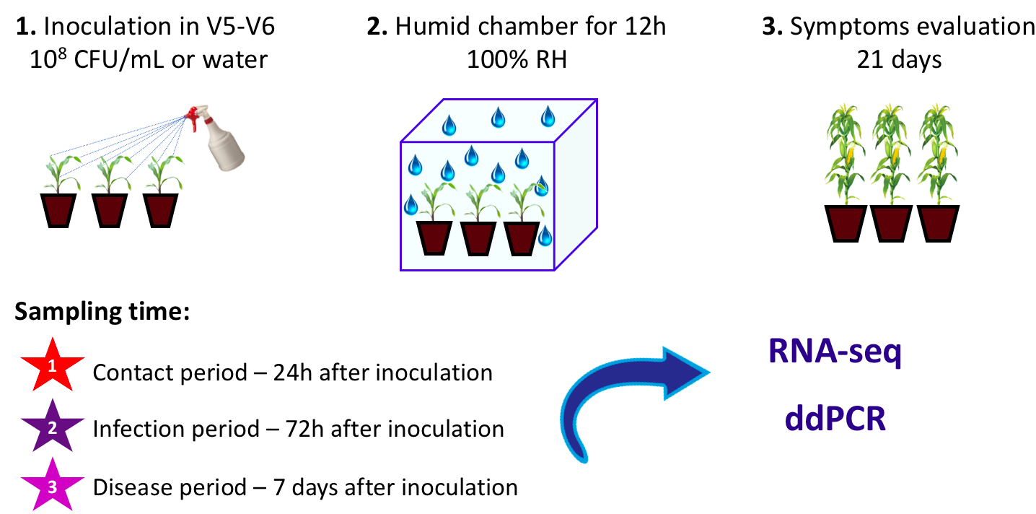
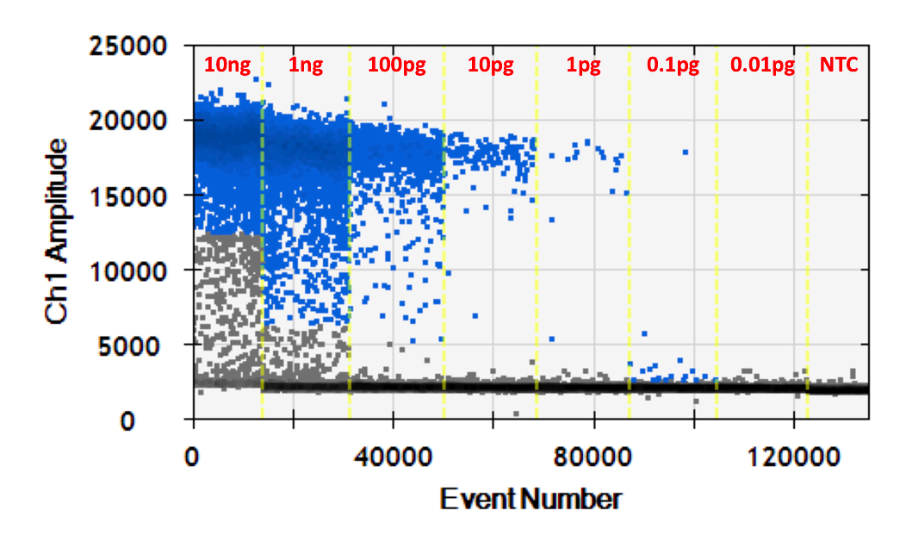
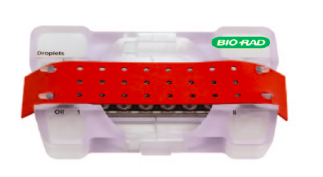
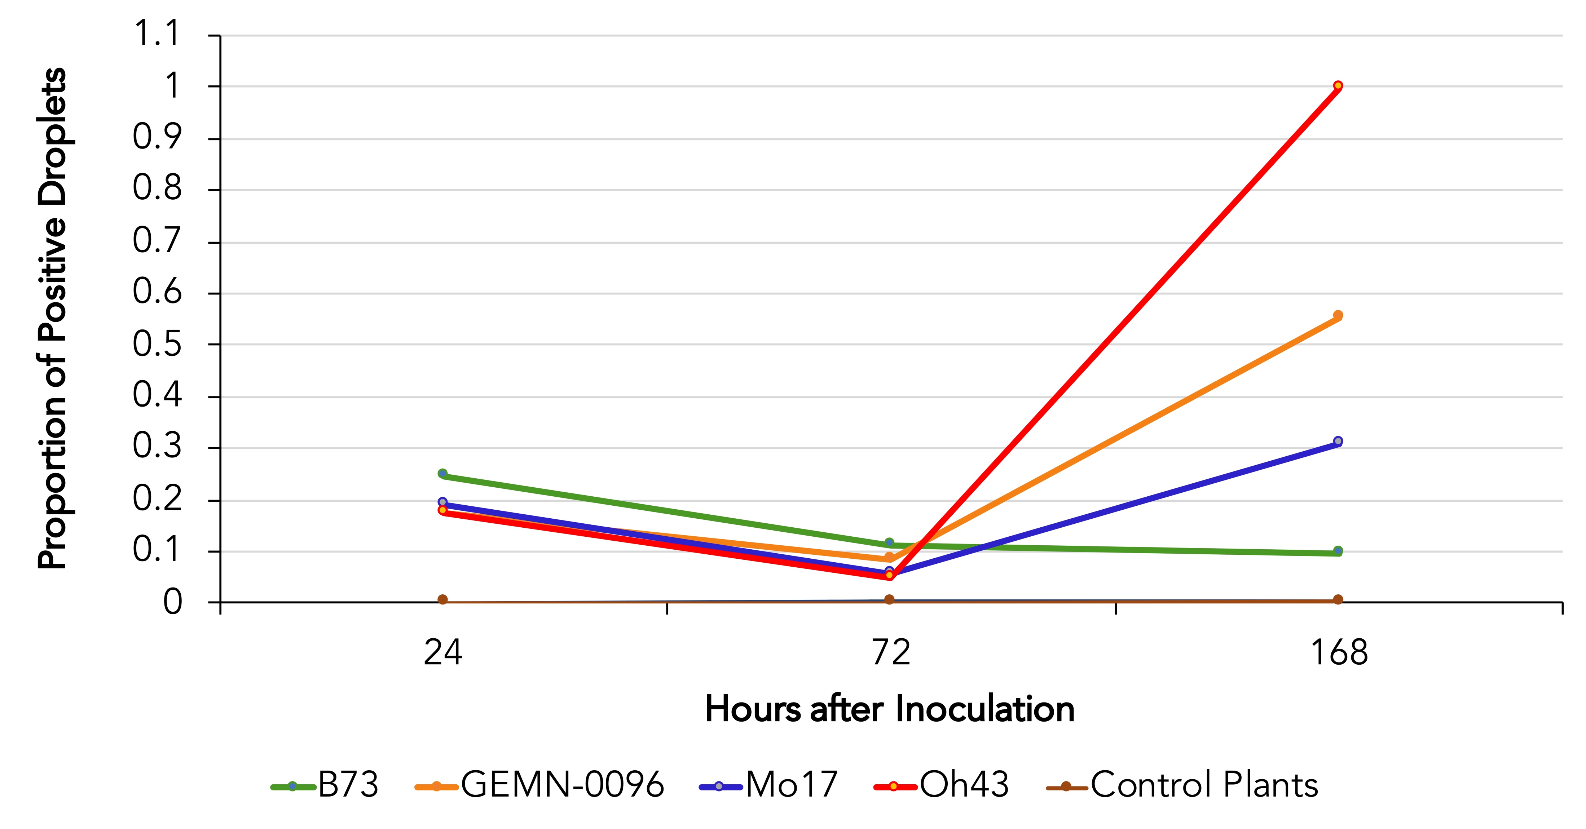
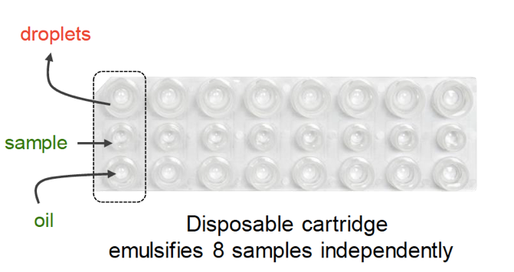
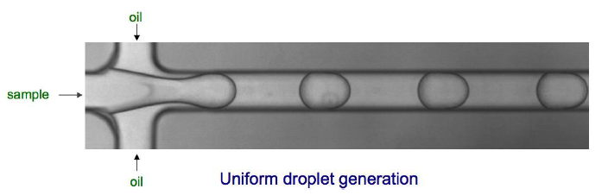
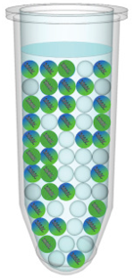
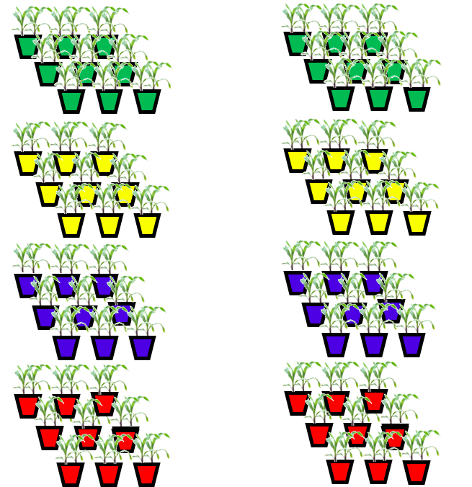
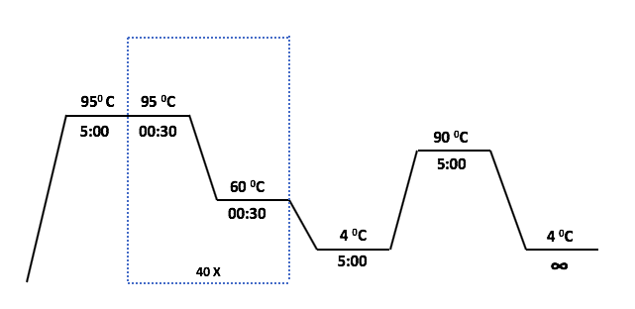
Detection and quantification of Xanthomonas vasicola pv vasculorum within the maize microbiome using Droplet-Digital PCR
Thaís Galhardo Egreja Ribeiro Silva¹, Joshua R. Herr^{1,2}
¹Department of Plant Pathology, University of Nebraska - Lincoln ²The Center for Plant Science Innovation, University of Nebraska – Lincoln
Introduction
Inoculation and Sampling
Detection Limit
Xanthomonas vasicola pv. vasculorum is the causal agent of Bacterial Leaf Streak on maize; This disease had not been documented in the USA prior to 2017 (Korus et al., 2017);
The demand for rapid methods for the quantification of pathogens is increasing. Among these methods, those based on nucleic acids amplification are the most widespread worldwide.
Based on the genome of Xvv we estimate that the amount of DNA per bacterial cell is approximately 5.3 x 10⁻⁶ ng.
The detection limit of pure culture was 0.1 pg/μl with a detection frequency of 100%. This corresponds to a minimum of 19 cells of Xvv.
There were no positive droplets (no detection) in the no template control.
Photo: CropWatch, UNL
After sampling and surface disinfestation with 70% ethanol, 20% bleach and autoclaved distilled water, DNA was isolated from the leaves using the IBI Scientific Soil DNA extraction kit, according to the manufacturer’s instructions.
Droplet-Digital PCR (ddPCR) can be used to absolutely quantify a target’s concentrations without the need for calibration, which simplifies both experimentation and data comparability (Hugget and Whale, 2013);
ddPCR Workflow
Objective
1
2
Figure1: The detection limit of ddPCR assay was determined using a 10-fold serial dilution of Xvv DNA. A concentration of 0.1 pg/μl was detected with a frequency of 100%. NTC: negative template control
Prepare PCR-Ready Samples
Make Droplets
The aim of this study was to develop a rapid and sensitive assay using ddPCR for detection and absolute quantification of Xvv within the maize microbiome.
This is part of an ongoing assessment of the interaction among Xvv, maize and the maize microbiome at the transcriptome level.
DNA samples and primers are combined with the EvaGreen supermix and 20 μl of your prepared samples are loaded into individual wells of the eight-channel disposable droplet generator cartridge.
Samples are then placed into the QX200 Droplet Generator, which utilizes proprietary reagents and microfluidics to partition the samples into 20,000 droplets. The droplets created are uniform in size and volume.
Pathogen Quantification
Experimental Design - Greenhouse
3
4
Inoculated Xvv (+)
Control (-)
Perform PCR
Read Droplets
Droplets are transferred to a 96-well plate for PCR amplification in any compatible thermal cycler.
Following PCR amplification of the nucleic acid target in the droplets, the samples are placed in the Droplet Reader, which analyzes each droplet individually. The droplet reader and its bundled QuantaSoft™ software count the PCR-positive and PCR-negative droplets.
B73
Figure 2: Quantification of Xvv with ddPCR in leaves from four maize genotypes at 24, 72 and 168 hours after inoculation.
GEMN-0096
Conclusions and Future Prospects
Based on preliminary results, ddPCR can be used as a diagnostic tool for sensitive, accurate, fast, and quantitative detection of Xvv.
Quantification of the pathogen in different maize genotypes, suggested this assay can also be used for evaluation of BLS resistance or tolerance.
These results will be used to support the metatranscriptome analysis that is being done to characterize the patterns of gene expression displayed by different maize genotypes and their microbial communities.
Mo17
ddPCR was performed on a BioRad QX200 system using EvaGreen assay.
The PCR reaction contained 11 μl of 2x EvaGreen Supermix, 0.25 μl of each 10 μM Xvv5 primer solution (Lang et al., 2017) and 2 μl of template (50ng) in a final volume of 22 μl.
Detection limit: a 10-fold serial dilution of 1 - 0.00001 ng/μl of DNA from pure bacterial suspension was prepared.
Oh43
Literature Cited
Acknowledgements
Huggett, Jim F., and Alexandra Whale. "Digital PCR as a novel technology and its potential implications for molecular diagnostics." (2013): 1691-1693.
Korus, K., et al. "First report of Xanthomonas vasicola causing bacterial leaf streak on corn in the United States." (2017).
Lang, J. M., et al. "Detection and Characterization of Xanthomonas vasicola pv. vasculorum (Cobb 1894) comb. nov. Causing Bacterial Leaf Streak of Corn in the United States." Phytopathology 107.11 (2017): 1312-1321.
This research was supported in part by University of Nebraska Lincoln’s Agricultural Research Division (ARD), Office of Research and Economic Development (ORED), and Center for Plant Science Innovation (PSI) Start-Up Funding. Additionally, we recognize funding from the US National Science Foundation EPSCoR RII Track 1 Award 180806 for the Center for Root & Rhizobiome Innovation.

